Slide 1
Laura Deans
RSP Math 8
Have a seat anywhere

Slide 2
I attended Western Washington University, Washington State. Finishing my Masters in Special Education (November!!!!)
I have been teaching for 8 years
I’m from Seattle – GO HUSKIES!!, GO SEAHAWKS!!
Both my boys graduated from LCHS and are now in Seattle going to school and working.

Slide 3
(2 or 3 is a good number to have)
Examples May Include:
To Prepare the Students for a higher level of education and promote critical thinking skills/application of scientific study/application of real-life math skills
To Develop the Students Understanding of…
To help students gain an appreciation of/for /the scientific world/ American literature/ useful math skills
Unit 1 | Unit 6
Unit 2 | Unit 7
Unit 3 | Unit 8
Unit 4 | Unit 9
Unit 5 | Unit 10

Slide 4
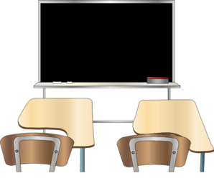
Students will treat their peers, the faculty and staff, and the classroom equipment with respect, and can expect it in return.
⭐No electronic use unless notified.
Come to class on time and prepared in two ways:
With all your materials. Trips to your locker will not be granted on a daily basis.
Focused and ready to learn: ask questions, keep an organized notebook, try your best.

Slide 5
Marshmallow Challenge

Slide 6
Name of Text Book
Please Make Sure Students Cover Their Text Books.
Cost to Replace if Lost:
$ _________
Picture of text book here (a simple Google search should yield some results that you can copy and paste into this presentation)

Slide 8
Include your late work policy here.

Slide 9
Describe your homework policy. You may want to include why you give homework, as it can be quite a hassle for parents these days. If you have a sound reason for giving homework, parents (and students) will appreciate it more. If you give homework consistently, you might want to have an idea of how much homework parents should expect their child to have each night (10 minutes, 30 minutes, etc.)

Slide 10
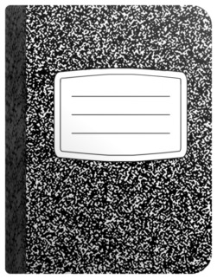
The purpose of an Interactive Student Notebook is to enable your child to be a creative, independent thinker and writer. Interactive notebooks will be used for class notes as well as for other activities in which you will be asked to express your own ideas and process the information presented in class. Interactive notebooks tend to have a learning curve, and we will learn as we go along.
If you do not use INBs, delete this slide. The space below would be a great spot to be pictures of past student work!

Slide 11
Students are required to keep a binder for this class. Binders contain all of their notes, quizzes, and classwork, including homework, reading exercises, interactive notebooking. Their binders will be very beneficial when studying for a test and will be graded {before every test/quarterly/etc.)
Neatness counts!
Feel free to modify for your classroom! You may call them notebooks or have different policies, etc.

Slide 12
As a classroom teacher, it is my duty to create an optimal learning environment for everybody in our class. If your child is disruptive, I will go over the expected behavior with them. I will communicate with you should any problems arise.
GENERAL COURSE OF ACTION:
Problem will be addressed with student; reminded of expected behavior.
Problem will be addressed with student. Parent will be contacted.
Student will need to stay after school; if problems persist meeting will be held.

Slide 13
(in your subject area)
Name of Test
Month of Test
Requirements (Depending on your state test, reasons will vary. Examples may include: students need it for college, students need it for graduation, data collection, etc. )
Any additional info

Slide 14
Email: Ldeans@lcusd.net
Phone: Office phone:
Office hours: By appointment
Google Classroom

Slide 15
Your Name
Class Name
Don’t call it “Open House?” Check out the LAST two slides to see if they suit you better. Delete the slides you wish not to use.

Slide 16
Your Name
Class Name
http://eepurl.com/bIGIdv

